Slide 1
C loops

Slide 2
C Loops
The looping can be defined as repeating the same process multiple times until a specific condition satisfies. There are three types of loops used in the C language. In this part of the tutorial, we are going to learn all the aspects of C loops.
Why use loops in C language?
The looping simplifies the complex problems into the easy ones. It enables us to alter the flow of the program so that instead of writing the same code again and again, we can repeat the same code for a finite number of times. For example, if we need to print the first 10 natural numbers then, instead of using the printf statement 10 times, we can print inside a loop which runs up to 10 iterations.
Advantage of loops in C
It provides code reusability.
Using loops, we do not need to write the same code again and again.
Using loops, we can traverse over the elements of data structures (array or linked lists).

Slide 3
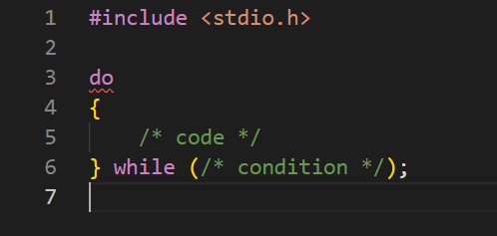
do-while loop in C
The do while loop is a post tested loop. Using the do-while loop, we can repeat the execution of several parts of the statements. The do-while loop is mainly used in the case where we need to execute the loop at least once. The do-while loop is mostly used in menu-driven programs where the termination condition depends upon the end user.
do
statement
true
Condition
false

Slide 4
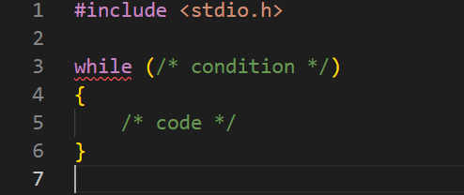
while loops
While loop is also known as a pre-tested loop. In general, a while loop allows a part of the code to be executed multiple times depending upon a given Boolean condition. It can be viewed as a repeating if statement. The while loop is mostly used in the case where the number of iterations is not known in advance.
Condition
true
false
statement

Slide 5
Properties of while loop
while loops
A conditional expression is used to check the condition. The statements defined inside the while loop will repeatedly execute until the given condition fails.
The condition will be true if it returns 0. The condition will be false if it returns any non-zero number.
In while loop, the condition expression is compulsory.
Running a while loop without a body is possible.
We can have more than one conditional expression in while loop.
If the loop body contains only one statement, then the braces are optional.

Slide 6
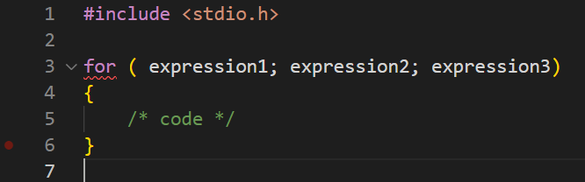
For loop in c
The for loop in C language is used to iterate the statements or a part of the program several times. It is frequently used to traverse the data structures like the array and linked list.
Initialization
Condition
false
true
statement
Inc/dec

